Slide 1


Terrain recognition using deep learning
Name of Team Member1: Ankita Navpute [AI4010]
Name of Team Member2:Saurabh Karpe [AI4066]
Name of Team Member3:Anil Riswal [AI4051]
Name of Team Member4:Sanyukta Rajput [AI4073]
Name of Team Member5:Harshwardhan Khotkar [AI4071]
Name of Team Member6:Hrushikesh Ambhore [AI4015]
Guide Name: Prof. D. P. Gadhe
Date of Presentation: 17-01-2024
Department of Artificial Intelligence and Data Science
AY 2022-23

Slide 2
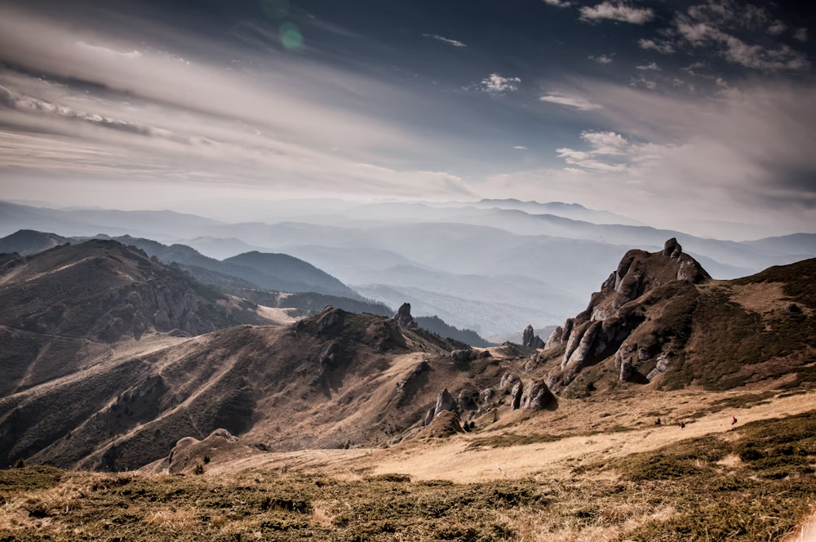
Introduction
Terrain refers to the physical characteristics of the Earth's surface, including its topography, vegetation, and other natural features.
There consist four types of terrain namely –Sandy,Rocky, Marshy & Grassy.
We Develop a model which can identify and classify the terrain and predict its roughness and slipperiness.
Fig 1 : Terrain

Slide 3
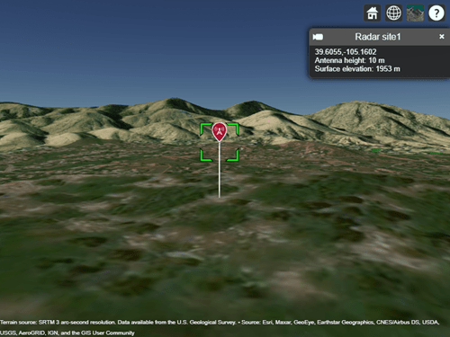
Existing methodology
As of present times, in terms of terrain modeling the existing methodologies underlying are Satellite imagery, Radar technology, Lidar technology. All these methodologies give a captured representation of terrains.
Fig 2 : Radar Technology

Slide 4
Proposed methodology
We develop a model which detects the terrain, classify terrain & predict is roughness or slipperiness.
We use Xception Architecture for prediction.
Use Of Convolutional Neural Network
Forming dataset as Grassy, Rocky, Sandy & Marshy, not a terrain.

Slide 5
Technologies used
Deep Learning model used - Xception net, Convolution Neural Network Methodology.
Libraries - Tenserflow, Keras, Pandas, Numpy, Matplotlib, Open-CV etc.
Frontend - Flask.

Slide 6
1.Details of algorithms used for training dl model
Step 1: Collection Of Dataset. We have collected dataset of 5 classes namely-grassy, rocky, sandy, marshy, not a terrain.
Step 2 : Preprocessing of the data for further analysis.
Step 3 : Feature extraction of images using the Xception net architecture. Capture important characteristics of the terrain.
Step 4 : Performance Evaluation of Model Using the Validation data
Step 5 : Application of Sobel filter. which apply parameters for roughness and slipperiness detection

Slide 7
1.2 Details of algorithms used for training dl model
PARAMETER | Range Values | Level | Implication
Roughness | 0 | Other Image | Image Other Than terrain
 | 1 | Low | Implies low roughness
 | 2 | Medium | Moderate Roughness
 | 3 | High | Terrain Is Highly Rough
Slipperiness | 0 | Other Image | Other than Terrain
 | 1 | Low | Terrain has high slipperiness
 | 2 | Medium | Terrain has moderate slipperiness
 | 3 | High | Terrain Has low slipperiness
.

Slide 8
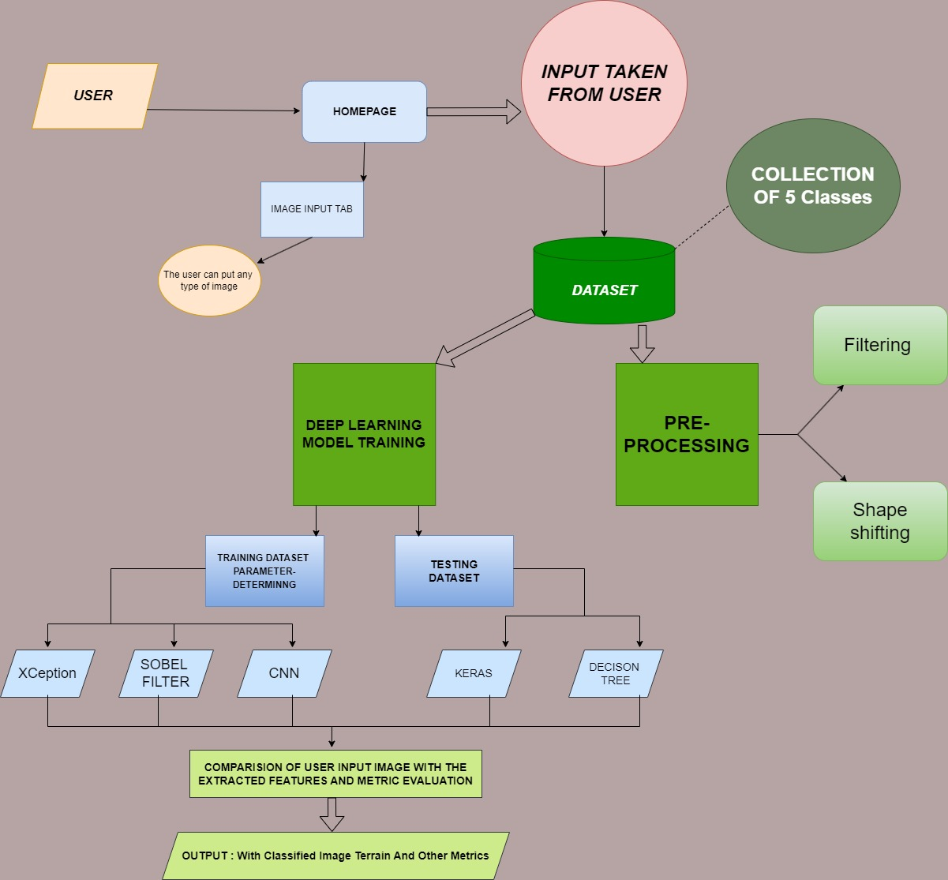
2. Block Diagram

Slide 9
Dataset description along with data splits
Dataset creation 1989 images of different terrains.
Distribution of images, 5 classes named-Grassy, Sandy, Rocky, Marshy and Other than terrain.
The spiltting of dataset into to training and testing for model training.
Dataset Split | Percentage | Images
Training | 80% | 1989
Testing | 20% | 397

Slide 10
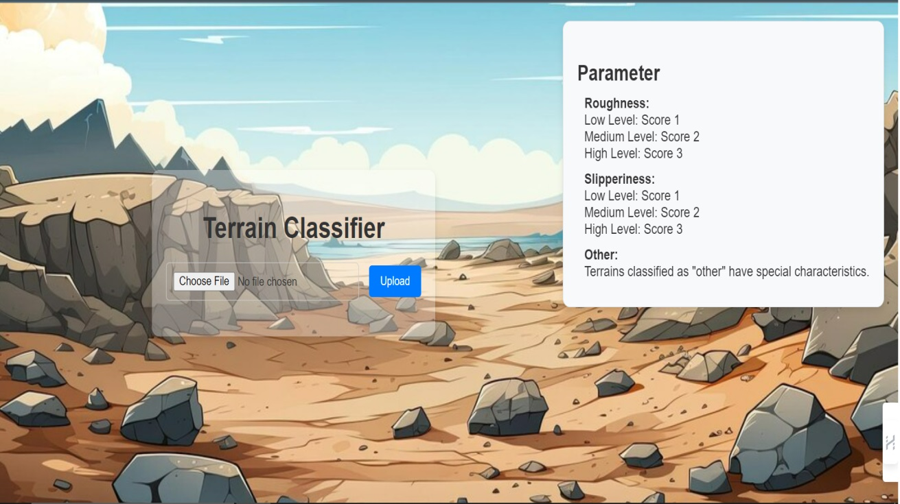
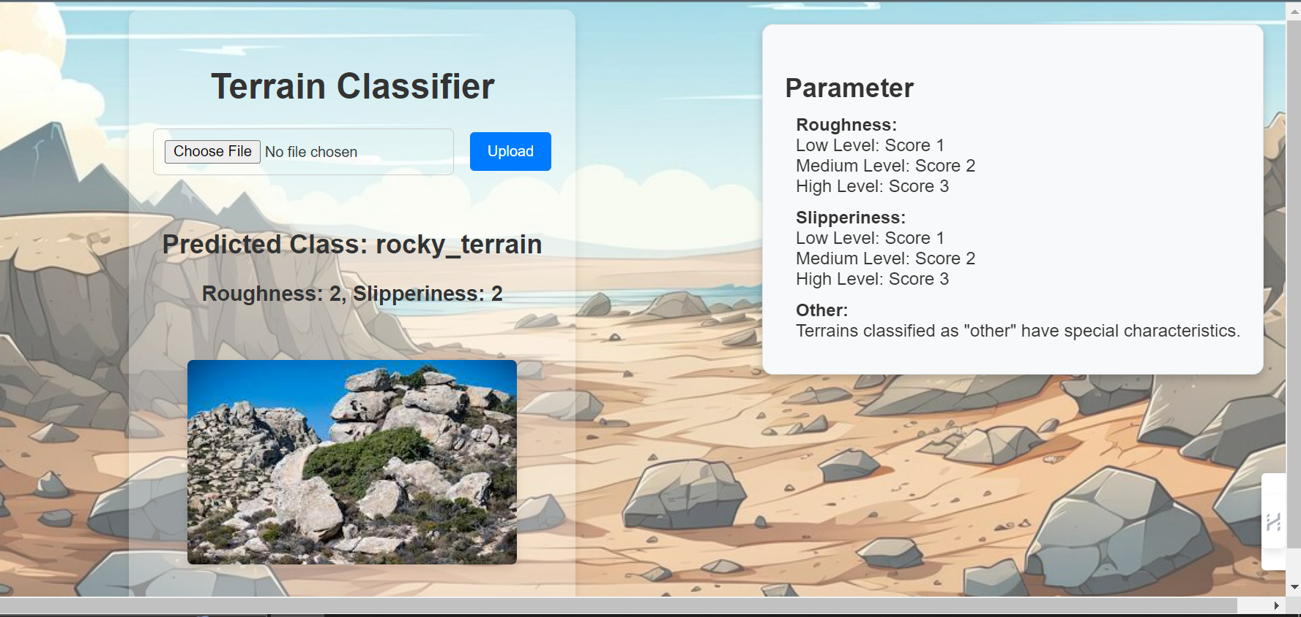
3.RESULTS
FRONT END
RESULT OF MODEL

Slide 11
Conclusion
In this work we created a dataset with useful images and train the model with different deep learning models and finally choose best suitable Xception Net.
In conclusion, by leveraging advanced algorithms and techniques, such a system aims to automatically identify and classify terrain with a high degree of accuracy and efficiency
which can be further used in many real time application and technologies.

Slide 12
future scope
Military and Defense: Detecting changes in terrain that may indicate the presence of hidden threats or enemy activity.
Autonomous Vehicles: Terrain recognition is crucial for self-driving cars, drones, and robots to navigate safely and avoid obstacles.
Natural Disaster Management: Assessing terrain in the aftermath of disasters to plan relief efforts and infrastructure repair.
Search and Rescue: Identifying optimal routes for search and rescue teams in various terrains.

Slide 13
References
[1] https://www.sciencedirect.com/journal/international-journal-of-applied-earth-observation-and-geoinformation
[2]sciencedirect.com%2fscience%https://www.researchgate.net/publication/280736853_Terrain_analysis_and_landform_recognition2farticle%2fpii%2fS1569843223000717/RK=2/RS=vaphvmdFn7Y9iWsXBZH2whO7XBM
[3]https://www.researchgate.net/publication/280736853_Terrain_analysis_and_landform_recognition
[4]https://www.youtube.com/watch?v=obe7foIZduk
[5]http://ieeexplore.ieee.org/document/8406736/

Slide 14

Questions?
Thank you!

